Slide 1
SCALABILITY ANALYSIS OF A PARALLELIZED PARTICLE SWARM OPTIMIZATION ALGORITHM FOR CALCULATING OPTIMAL POWER FLOW
BRIAN MUKESWE, MSC CANDIDATE​
DATA SCIENCE, TECHNOLOGY AND INNOVATION​
SCHOOL OF INFORMATICS
March 29, 2021

Slide 2

Particle Swarm Optimization
Swarm Intelligence
Heuristic search
Agents called “Particles”
Personal best solution
Global best solution
Exploration vs Exploitation
Evolutionary Algorithm
This Photo by Unknown Author is licensed under CC BY-SA

Slide 3
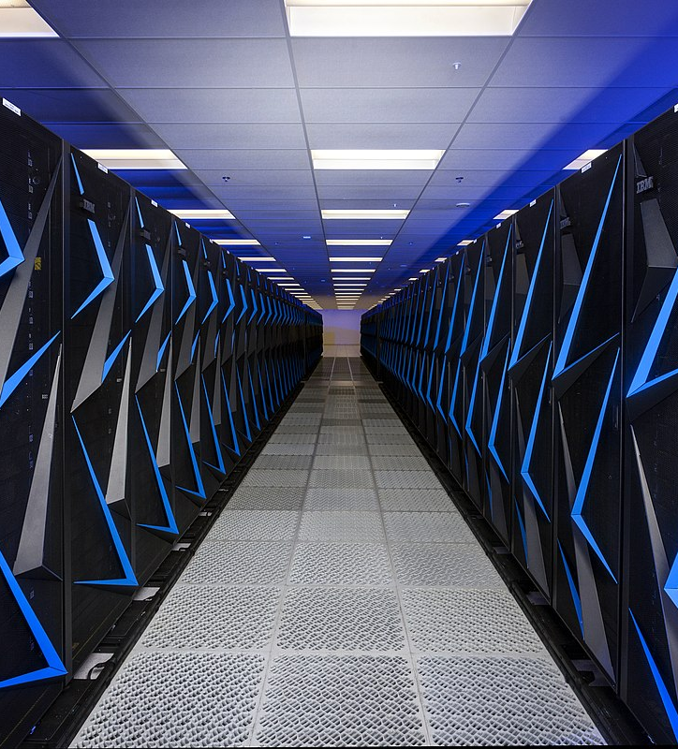
Parallel Computing
Concurrency
Serial vs Parallel
Parallelization
Speed Up
High Performance Computing
Cirrus HPC System
This Photo by Unknown Author is licensed under CC BY-SA

Slide 4
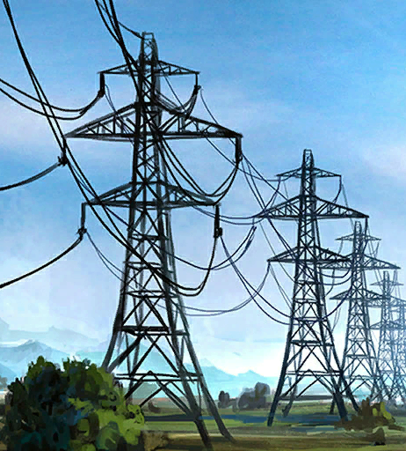
Optimal Power Flow
Power Loss Minimization
Control Parameters
Physical Limitations
Time Constraints
This Photo by Unknown Author is licensed under CC BY-SA-NC

Slide 5
Power Loss Minimization

Slide 6
Objectives
Improve optimality by using more particles
Reduce iteration time by parallelization

Slide 7
Work Undertaken

Slide 8
Work Undertaken

Slide 9
Objectives
Improve optimality by using more particles
Reduce iteration time by parallelization

Slide 10
Results & Analysis

Slide 11
Results & Analysis

Slide 12
Objectives
Improve optimality by using more particles
Reduce iteration time by parallelization

Slide 13
Results & Analysis

Slide 14
Conclusion
Optimality improves with more particles
Parallelization yields significant Speed Up
Results suggest that parallelization can make PSO practical for optimization in real-time or hour-ahead electricity markets.
Future research:
Experiment with real-world power system model, instead of benchmark models.
Apply techniques to the multi-objective OPF problem

Slide 15
Appendix

Slide 16
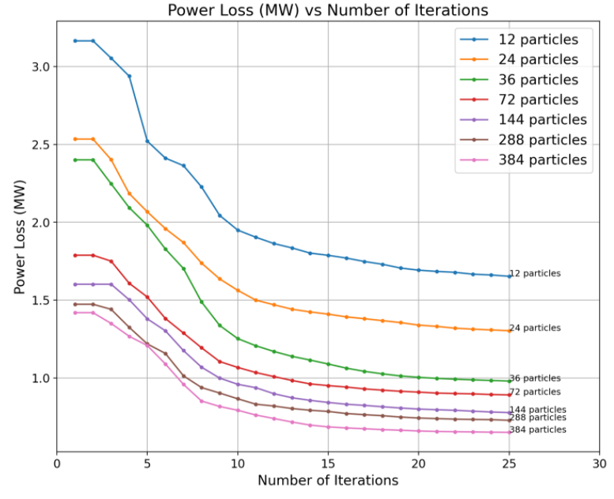

Slide 18
